Slide 1

Valley Credit Union Q4 2024 IT Dashboard
IT metrics and security dashboard aligned to source report
Notes:
AI-generated content may be incorrect. ---

Slide 2
Executive Overview
Notes:
--- This slide references information from the following file: https://nscc-my.sharepoint.com/personal/w0516036_campus_nscc_ca/_layouts/15/Doc.aspx?sourcedoc=%7B35B66E70-5B48-4185-AE01-B42A2B56ABB7%7D&file=Valley%20Credit%20Union%20Q3%202025%20IT%20Dashboard%20(2).docx&action=default&mobileredirect=true Executive Summary

Slide 3
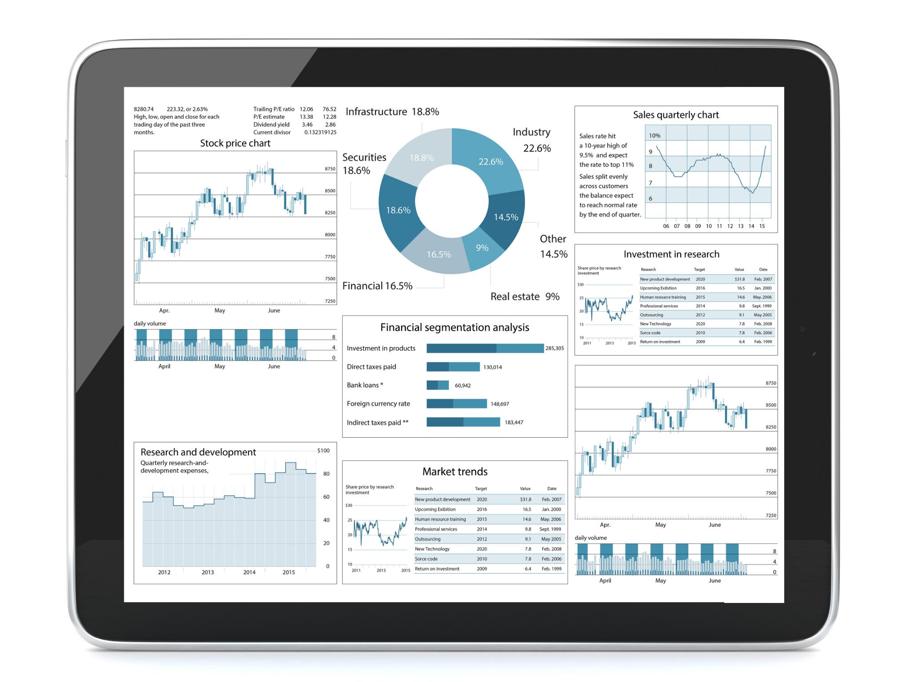
Executive Summary
Active Users: 67
Total Computers: 78
Servers: 5
Microsoft Defender for Business licenses: 78
0 threats found in the last 30 days
Notes:
--- This slide references information from the following file: https://nscc-my.sharepoint.com/personal/w0516036_campus_nscc_ca/_layouts/15/Doc.aspx?sourcedoc=%7B35B66E70-5B48-4185-AE01-B42A2B56ABB7%7D&file=Valley%20Credit%20Union%20Q3%202025%20IT%20Dashboard%20(2).docx&action=default&mobileredirect=true This executive dashboard provides a consolidated view of Valley Credit Union’s information technology environment for the fourth quarter of 2024. Overall, the IT landscape remains stable, secure, and operationally effective. Core infrastructure systems are functioning as expected, and end-user productivity platforms continue to support daily business operations without disruption. No cybersecurity threats were detected during the reporting period, indicating effective baseline security controls and monitoring. From an executive perspective, the organization demonstrates sound operational discipline, with strong licensing coverage across Microsoft productivity and security tools, centralized printer management, and active monitoring of public-facing services. The institution benefits from a mature cybersecurity awareness culture, as reflected in its Beauceron score, which indicates high user engagement with security education and training initiatives. Opportunities for improvement remain, particularly in the area of patch compliance consistency across all endpoints and the optimization of Microsoft Defender Secure Score. Addressing these areas will further reduce operational risk, improve audit readiness, and strengthen the overall security posture. This dashboard is intended to support informed decision-making, risk oversight, and strategic planning at the executive and board levels.

Slide 4

Users, Devices, and Infrastructure
Notes:
--- This slide references information from the following file: https://nscc-my.sharepoint.com/personal/w0516036_campus_nscc_ca/_layouts/15/Doc.aspx?sourcedoc=%7B35B66E70-5B48-4185-AE01-B42A2B56ABB7%7D&file=Valley%20Credit%20Union%20Q3%202025%20IT%20Dashboard%20(2).docx&action=default&mobileredirect=true User and Device Overview, Server Infrastructure

Slide 5


User and Device Overview
Active Users: 67
Total Computers: 78
Windows 10 Pro: 48
Windows 11 Pro: 30
Windows Server 2019 Standard: 3
Windows Server 2012 R2 Standard: 2
Notes:
--- This slide references information from the following file: https://nscc-my.sharepoint.com/personal/w0516036_campus_nscc_ca/_layouts/15/Doc.aspx?sourcedoc=%7B35B66E70-5B48-4185-AE01-B42A2B56ABB7%7D&file=Valley%20Credit%20Union%20Q3%202025%20IT%20Dashboard%20(2).docx&action=default&mobileredirect=true Valley Credit Union currently supports 67 active users across the organization, reflecting the core workforce relying on IT systems for daily operations. These users are supported by a total of 78 endpoint devices, indicating a modest buffer of spare or shared systems that contribute to operational flexibility and business continuity. The endpoint environment consists of a mix of Windows 10 Pro and Windows 11 Pro devices, with 48 systems still operating on Windows 10 and 30 already upgraded to Windows 11. This distribution suggests a gradual and controlled transition toward newer operating systems, which is a prudent approach for minimizing disruption while maintaining compatibility with critical business applications. From a risk and lifecycle management standpoint, continued planning for the eventual retirement of Windows 10 systems will be important to ensure ongoing vendor support and security updates. Overall, the user and device footprint is well-aligned with the organization’s size and operational needs.

Slide 6
Server Infrastructure
Modern Server Platforms
Three servers run Windows Server 2019, providing a stable and well-supported platform for core business applications.
Legacy Server Risks
Two servers using Windows Server 2012 R2 pose increased operational and security risks due to reduced vendor support.
Need for Modernization
Prioritizing legacy server upgrades reduces risk, enhances compliance, and supports future scalability.
Notes:
--- This slide references information from the following file: https://nscc-my.sharepoint.com/personal/w0516036_campus_nscc_ca/_layouts/15/Doc.aspx?sourcedoc=%7B35B66E70-5B48-4185-AE01-B42A2B56ABB7%7D&file=Valley%20Credit%20Union%20Q3%202025%20IT%20Dashboard%20(2).docx&action=default&mobileredirect=true The server environment at Valley Credit Union consists of five total servers supporting core business and infrastructure services. Three of these servers are running Windows Server 2019 Standard, which remains a modern and well-supported platform suitable for production workloads. These systems provide a stable foundation for critical applications and internal services. Two servers continue to operate on Windows Server 2012 R2 Standard, which is considered legacy technology. While these systems may still be functional, they represent an increased operational and security risk due to reduced vendor support and limited access to modern security features. From an executive risk management perspective, these legacy servers should be prioritized for modernization or replacement as part of a planned infrastructure refresh. Proactively addressing this will reduce long-term risk exposure, improve compliance alignment, and support future scalability.

Slide 7

Productivity, Security, and Operations
Notes:
--- This slide references information from the following file: https://nscc-my.sharepoint.com/personal/w0516036_campus_nscc_ca/_layouts/15/Doc.aspx?sourcedoc=%7B35B66E70-5B48-4185-AE01-B42A2B56ABB7%7D&file=Valley%20Credit%20Union%20Q3%202025%20IT%20Dashboard%20(2).docx&action=default&mobileredirect=true Microsoft Licensing and Collaboration, Security and Compliance Posture, Patch Management and Operational Metrics

Slide 8

Microsoft Licensing and Collaboration
Microsoft 365 Business Premium: 76/78
Microsoft 365 Business Standard: 30/30
Microsoft Teams Phone with calling plan: 82/84
Email volume (last 30 days): Sent 5,377 / Received 23,370
Printers: 21 (managed by Xtra Documents)
Notes:
--- This slide references information from the following file: https://nscc-my.sharepoint.com/personal/w0516036_campus_nscc_ca/_layouts/15/Doc.aspx?sourcedoc=%7B35B66E70-5B48-4185-AE01-B42A2B56ABB7%7D&file=Valley%20Credit%20Union%20Q3%202025%20IT%20Dashboard%20(2).docx&action=default&mobileredirect=true Microsoft 365 licensing across the organization is largely comprehensive and well-managed. Valley Credit Union currently holds 76 out of 78 licenses for Microsoft 365 Business Premium, ensuring that the majority of users have access to advanced productivity, security, and device management features. All 30 required Microsoft 365 Business Standard licenses are fully allocated, demonstrating effective capacity planning. In addition, Microsoft Teams Phone with calling plans is licensed for 82 out of 84 users, supporting unified communications and modern telephony capabilities. From an executive standpoint, this near-complete licensing coverage minimizes operational friction, supports collaboration, and ensures that security features embedded within Microsoft 365 are broadly available. Minor gaps in licensing can be addressed easily to achieve full alignment and eliminate potential inconsistencies.

Slide 9

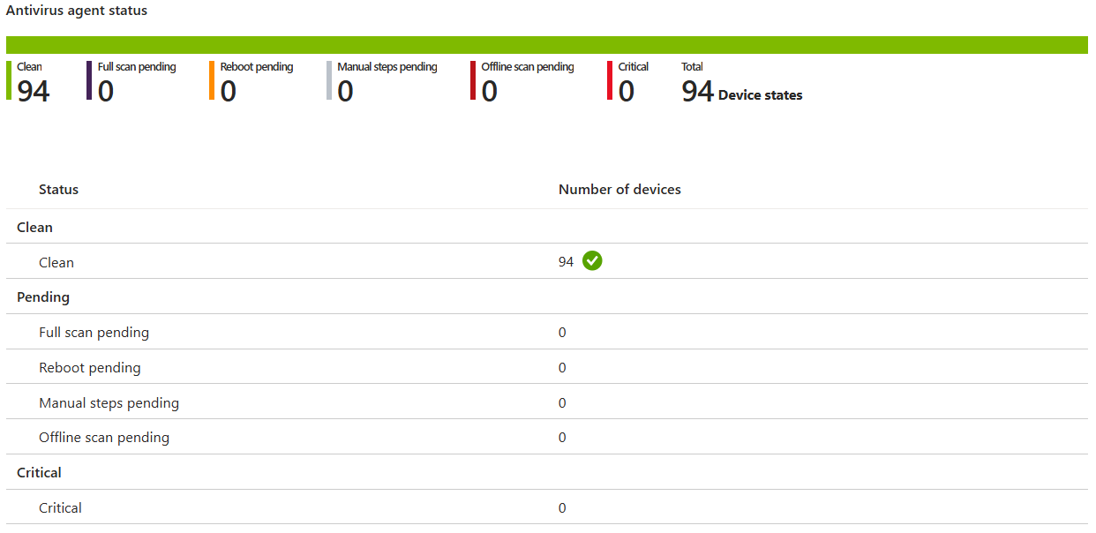
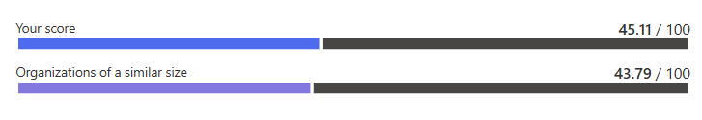
Security and Compliance Posture
MS Defender Score: 45.11%
Overall score is higher than organizations of similar size
Microsoft Defender for Business licenses: 78
0 threats found in the last 30 days
Overall Secure Score shown in screenshots
Notes:
--- This slide references information from the following file: https://nscc-my.sharepoint.com/personal/w0516036_campus_nscc_ca/_layouts/15/Doc.aspx?sourcedoc=%7B35B66E70-5B48-4185-AE01-B42A2B56ABB7%7D&file=Valley%20Credit%20Union%20Q3%202025%20IT%20Dashboard%20(2).docx&action=default&mobileredirect=true The organization maintains a solid baseline security posture, supported by Microsoft Defender for Business licensing across 78 endpoints. The Microsoft Defender Secure Score currently stands at 45.11%, which is higher than that of comparable organizations of similar size. This score indicates that foundational security controls are in place, while also highlighting opportunities for further configuration improvements. Importantly, no security threats were detected in the past 30 days, underscoring the effectiveness of current monitoring and protection measures. From a governance and oversight perspective, continued focus on improving the Secure Score will strengthen defense-in-depth, enhance audit outcomes, and further reduce cyber risk. Incremental improvements in configuration and policy enforcement can yield meaningful gains without significant capital investment.

Slide 10


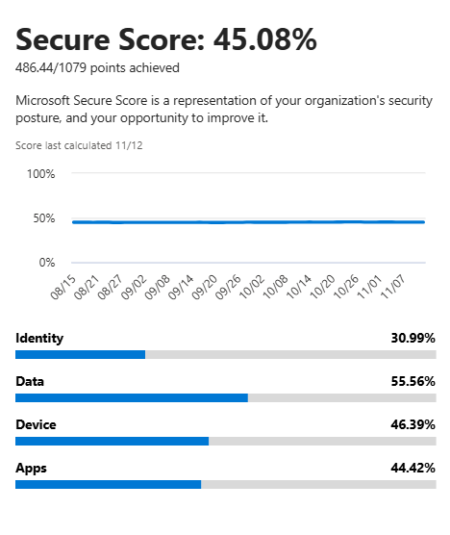
Patch Management and Operational Metrics
Patches applied on Endpoints in Q4:
100% patches applied on 73 endpoints (including servers)
80% patches applied at 9 endpoints
NIST update: MCS minutes
See attached NIST tracker and MCS minutes
Notes:
--- This slide references information from the following file: https://nscc-my.sharepoint.com/personal/w0516036_campus_nscc_ca/_layouts/15/Doc.aspx?sourcedoc=%7B35B66E70-5B48-4185-AE01-B42A2B56ABB7%7D&file=Valley%20Credit%20Union%20Q3%202025%20IT%20Dashboard%20(2).docx&action=default&mobileredirect=true Patch management performance is strong overall, with 100 percent patch compliance achieved on 73 endpoints, including servers. This reflects disciplined operational processes and effective endpoint management. However, nine endpoints are currently operating at approximately 80 percent patch compliance, which represents a manageable but notable area of risk. From an executive risk lens, closing this gap should be a short-term priority to ensure consistent protection across the entire environment. Operational productivity metrics further demonstrate system stability, with 5,377 emails sent and 23,370 emails received in the past 30 days. These figures indicate normal business activity levels and confirm the reliability of core communication platforms.

Slide 11

Risk Awareness and Governance
Notes:
--- This slide references information from the following file: https://nscc-my.sharepoint.com/personal/w0516036_campus_nscc_ca/_layouts/15/Doc.aspx?sourcedoc=%7B35B66E70-5B48-4185-AE01-B42A2B56ABB7%7D&file=Valley%20Credit%20Union%20Q3%202025%20IT%20Dashboard%20(2).docx&action=default&mobileredirect=true Cyber Awareness and External Risk Monitoring, Governance, Compliance, and Reporting

Slide 12

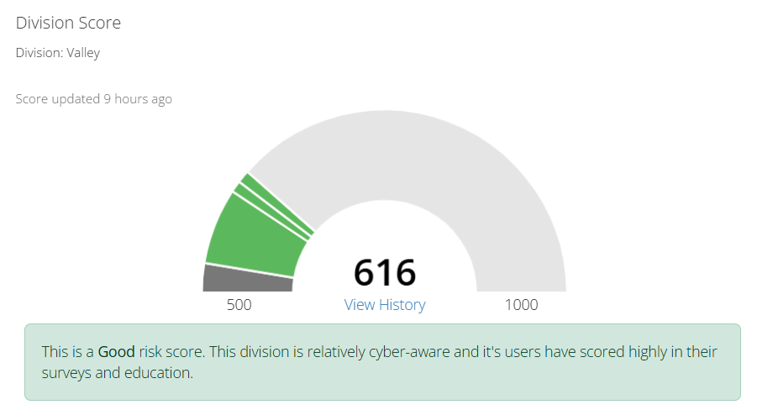

Cyber Awareness and External Risk Monitoring
Beauceron Score: 616
Beauceron is the cyber awareness and monitoring platform
Strong user survey and education outcomes indicate high cyber awareness
Notes:
--- This slide references information from the following file: https://nscc-my.sharepoint.com/personal/w0516036_campus_nscc_ca/_layouts/15/Doc.aspx?sourcedoc=%7B35B66E70-5B48-4185-AE01-B42A2B56ABB7%7D&file=Valley%20Credit%20Union%20Q3%202025%20IT%20Dashboard%20(2).docx&action=default&mobileredirect=true Valley Credit Union demonstrates a strong culture of cybersecurity awareness, as evidenced by a Beauceron score of 616. This score reflects high levels of user participation in security training and awareness programs, which is a critical control for reducing the risk of phishing, social engineering, and human-factor incidents. In addition to internal awareness, the organization leverages Coalition Control to continuously monitor public-facing internet services associated with valleycreditunion.com. The most recent external scan was completed six days ago, providing timely visibility into potential external vulnerabilities. Together, these measures support proactive risk management and align well with executive and board expectations for cyber oversight.

Slide 13

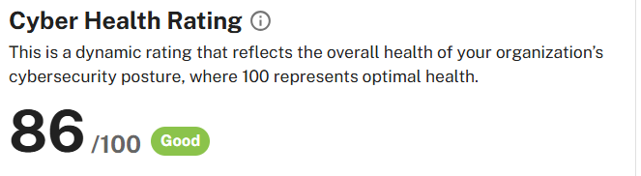
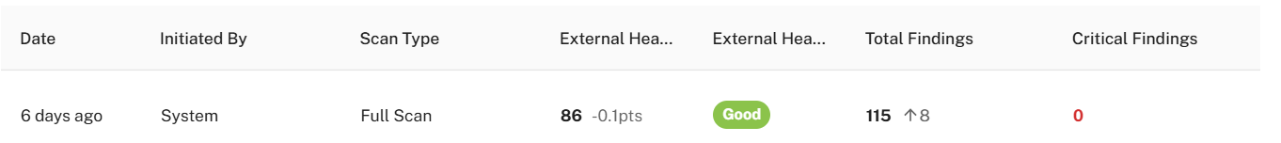
Governance, Compliance, and Reporting
Risk Report:
Coalition Control scans public-facing internet services for valleycreditunion.com
Most recent scan: 6 days ago
NIST tracker and MCS minutes referenced in source report
Notes:
--- This slide references information from the following file: https://nscc-my.sharepoint.com/personal/w0516036_campus_nscc_ca/_layouts/15/Doc.aspx?sourcedoc=%7B35B66E70-5B48-4185-AE01-B42A2B56ABB7%7D&file=Valley%20Credit%20Union%20Q3%202025%20IT%20Dashboard%20(2).docx&action=default&mobileredirect=true Governance and compliance activities are supported through ongoing NIST updates and the maintenance of MCS meeting minutes, which are tracked in an attached governance tracker. This approach ensures that cybersecurity and IT risk discussions are documented, traceable, and aligned with recognized frameworks. From an executive and audit-readiness perspective, this level of documentation supports regulatory expectations and demonstrates due diligence in IT oversight. The inclusion of visual dashboards and screenshots within the presentation further enhances transparency, enabling leadership to quickly understand risk posture, performance trends, and areas requiring attention. Collectively, these practices position Valley Credit Union with a defensible and well-governed IT environment.

